Slide 1
Different Layer Configurations on Deeper Network Topologies
Team-9
Dawana grace raj
Jai Soni
Nikhil kohli

Slide 2
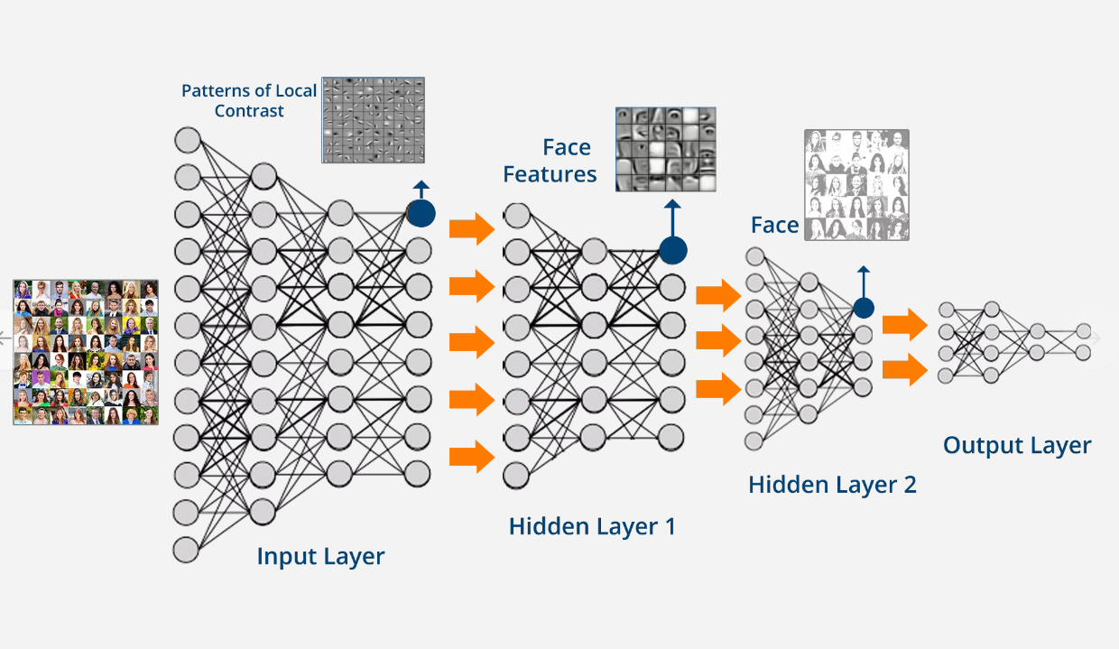

Slide 3
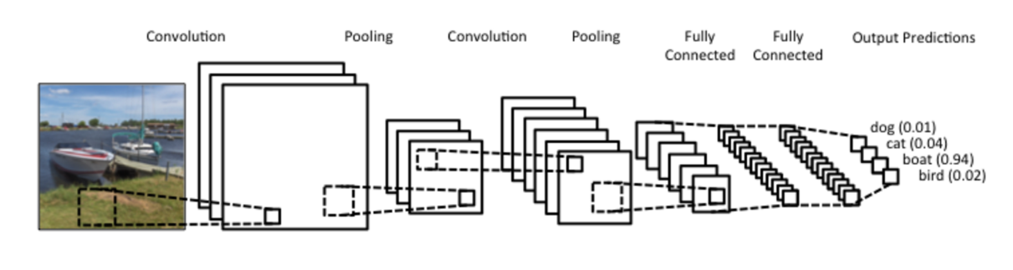

Slide 5
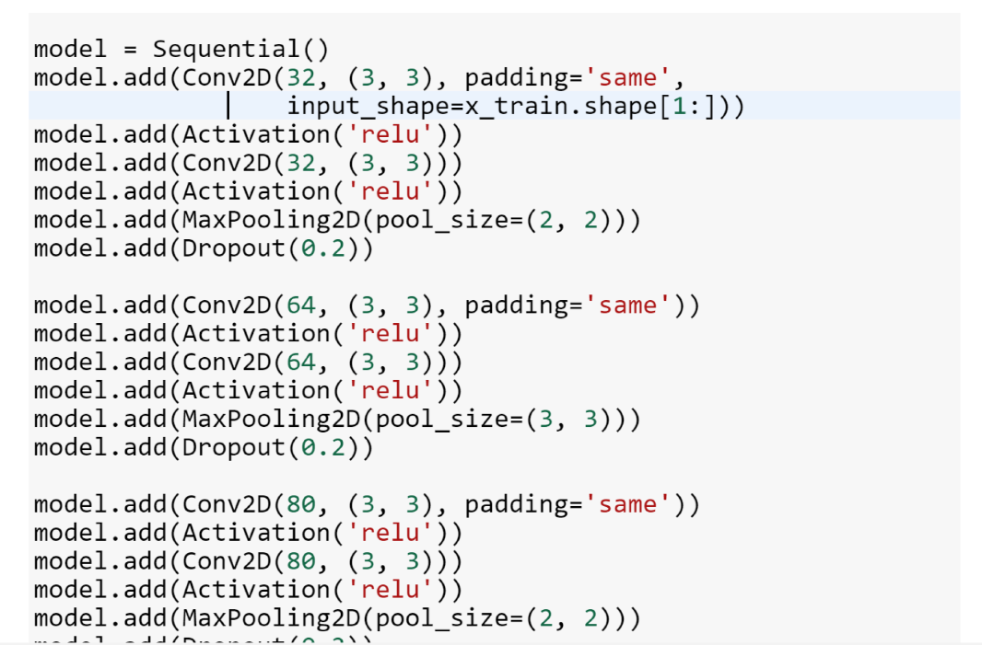

Slide 6
HYPER PARAMETER OPTIMIZATION
FOR DEEPER NEURAL NETWORKS

Slide 7
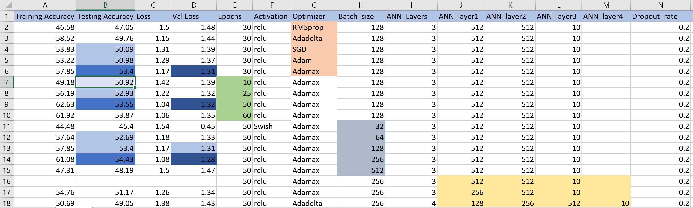

Slide 8
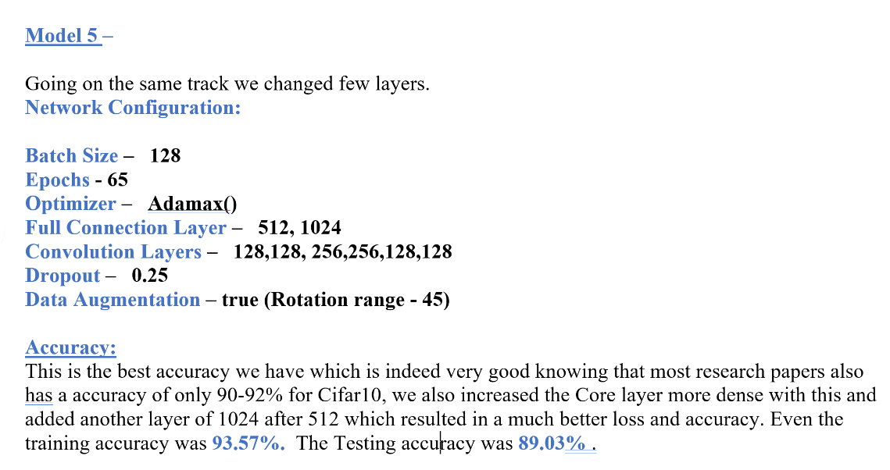

Slide 9
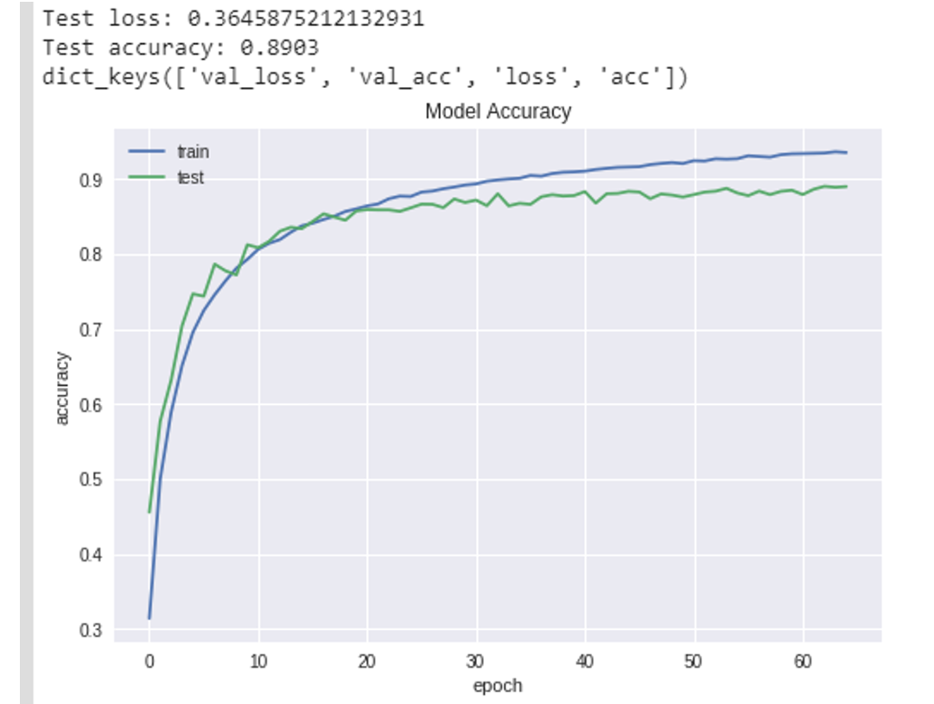

Slide 10
